Slide 1
Nakuja Internship 2026
Solid Propulsion Team
Weekly report #9
Presented by: Paschal Peter
August 17, 2026

Slide 2
Last week’s tasks
Cooking of grains for 3 grain static tests
Machining of core rods
Motor assembly for 3 grain test
Static test dry run (To test new ignition circuit hardware)
Liner preparation
Ignitor preparation

Slide 3
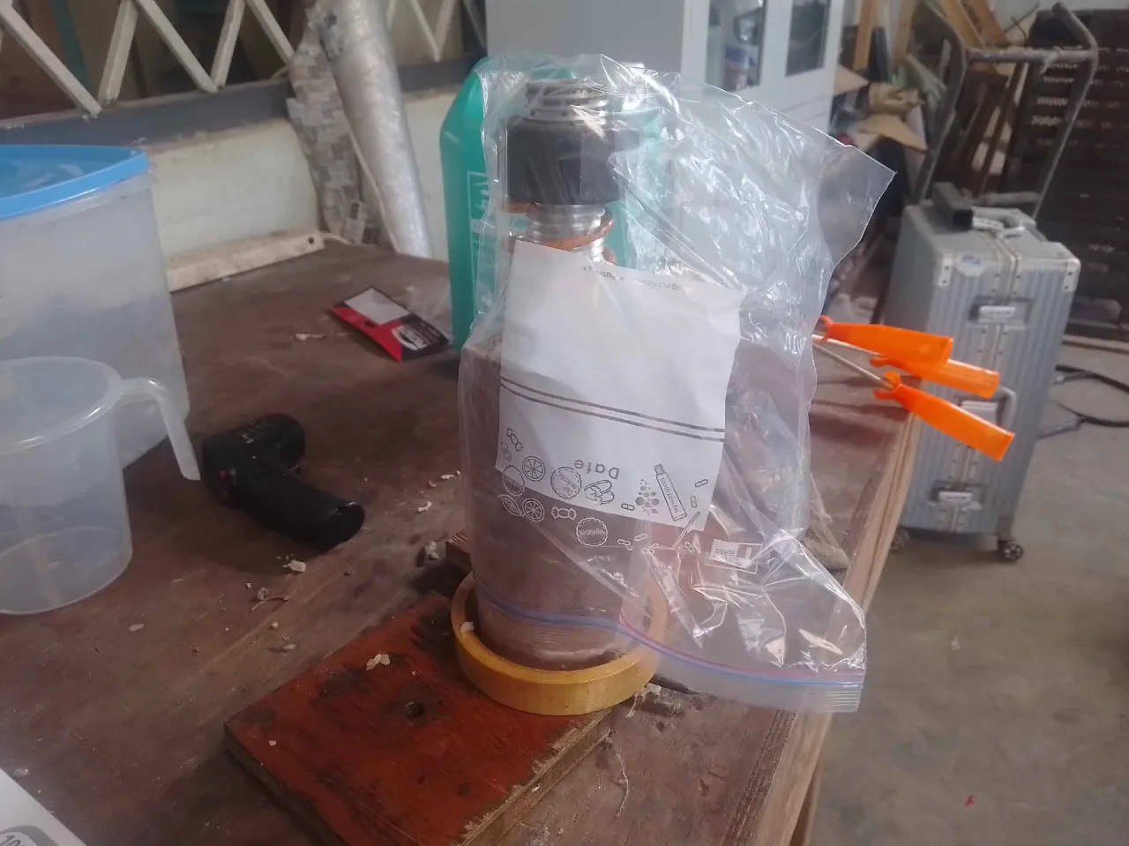
Cooking of grains for 3 grain test
Purpose: These grains will be used during the 3 grain static test which will be held on Monday 17/08/2026.
Result: 3 out of 12 grains have been prepared

Slide 4
2. Machining of core rods
Purpose: In preparation for mass production, the machining sub-team has been machining 3 new core rods to help increase number of grains cooked per day
Result: The Aluminium 7075 core rods were turned to a diameter of 38 mm from 50 mm, the remaining operation is threading and once done be Monday 17/08/2026, the propellant sub-team can now easily mass-produce the propellant grains.

Slide 5
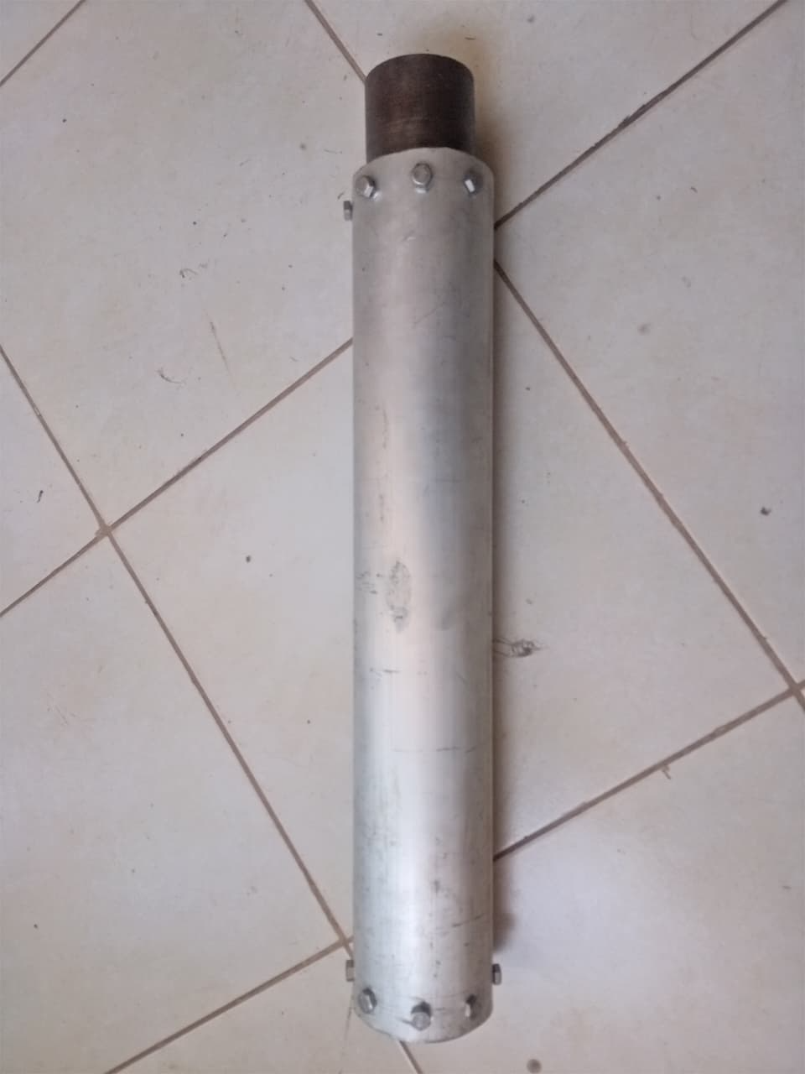
3. Motor assembly for 3 grain test
Purpose: In preparation for the 3 grain test, the propellant sub-team has been drilling, tapping and assembling the dry Solid Rocket Motor. This test will be done on Monday 17/08/2026
Result:

Slide 6
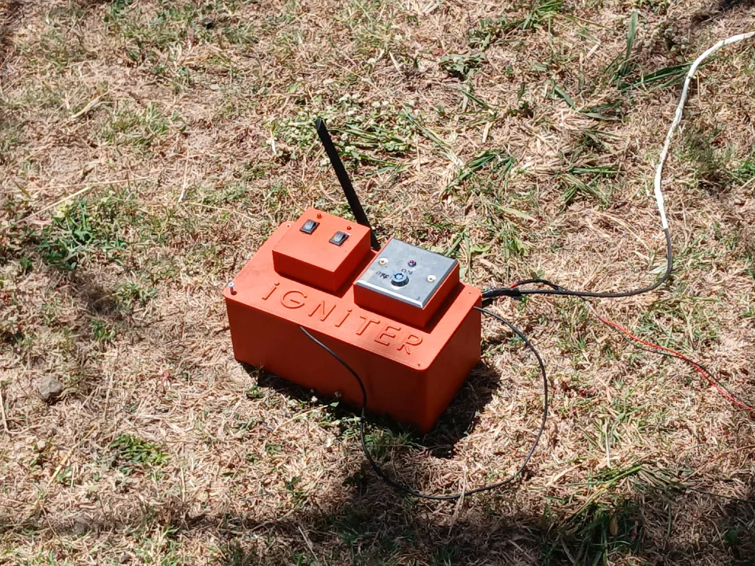
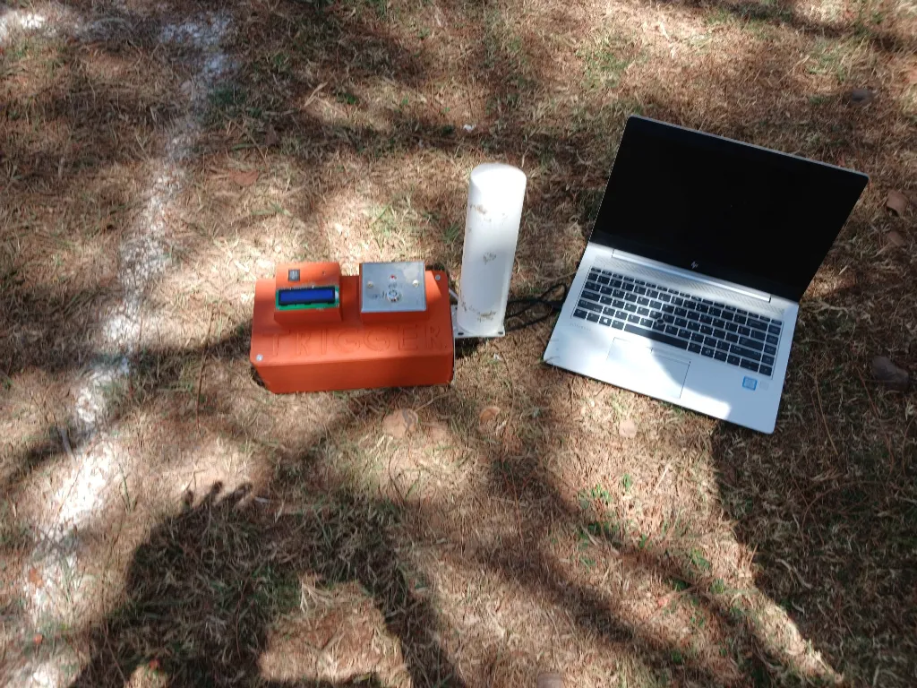
4. Static test dry run
Purpose: On addition of new hardware i.e. 3D printed case, LCD screen etc, the ignition subteam performed a dry run to ensure the ignition circuit was working (both trigger and igniter).
Result: The dry run was a success and we can proceed with the static test on Monday.

Slide 7
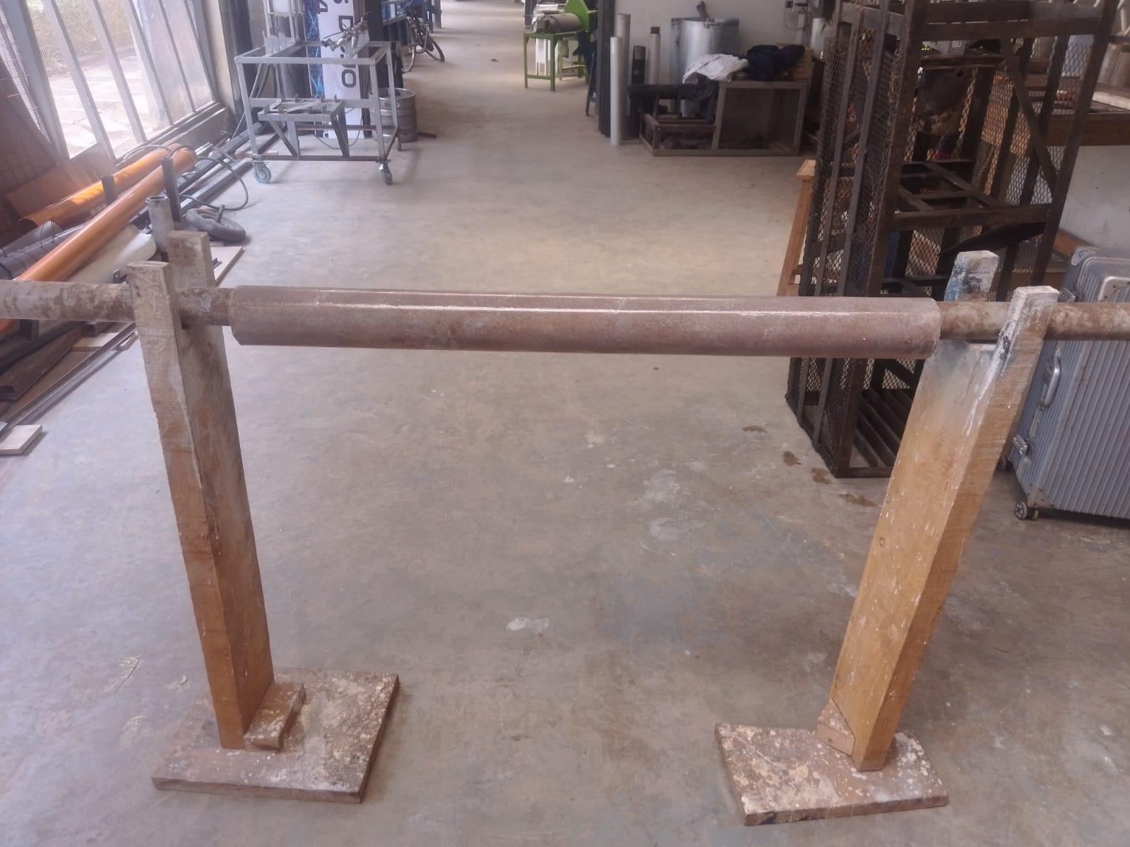
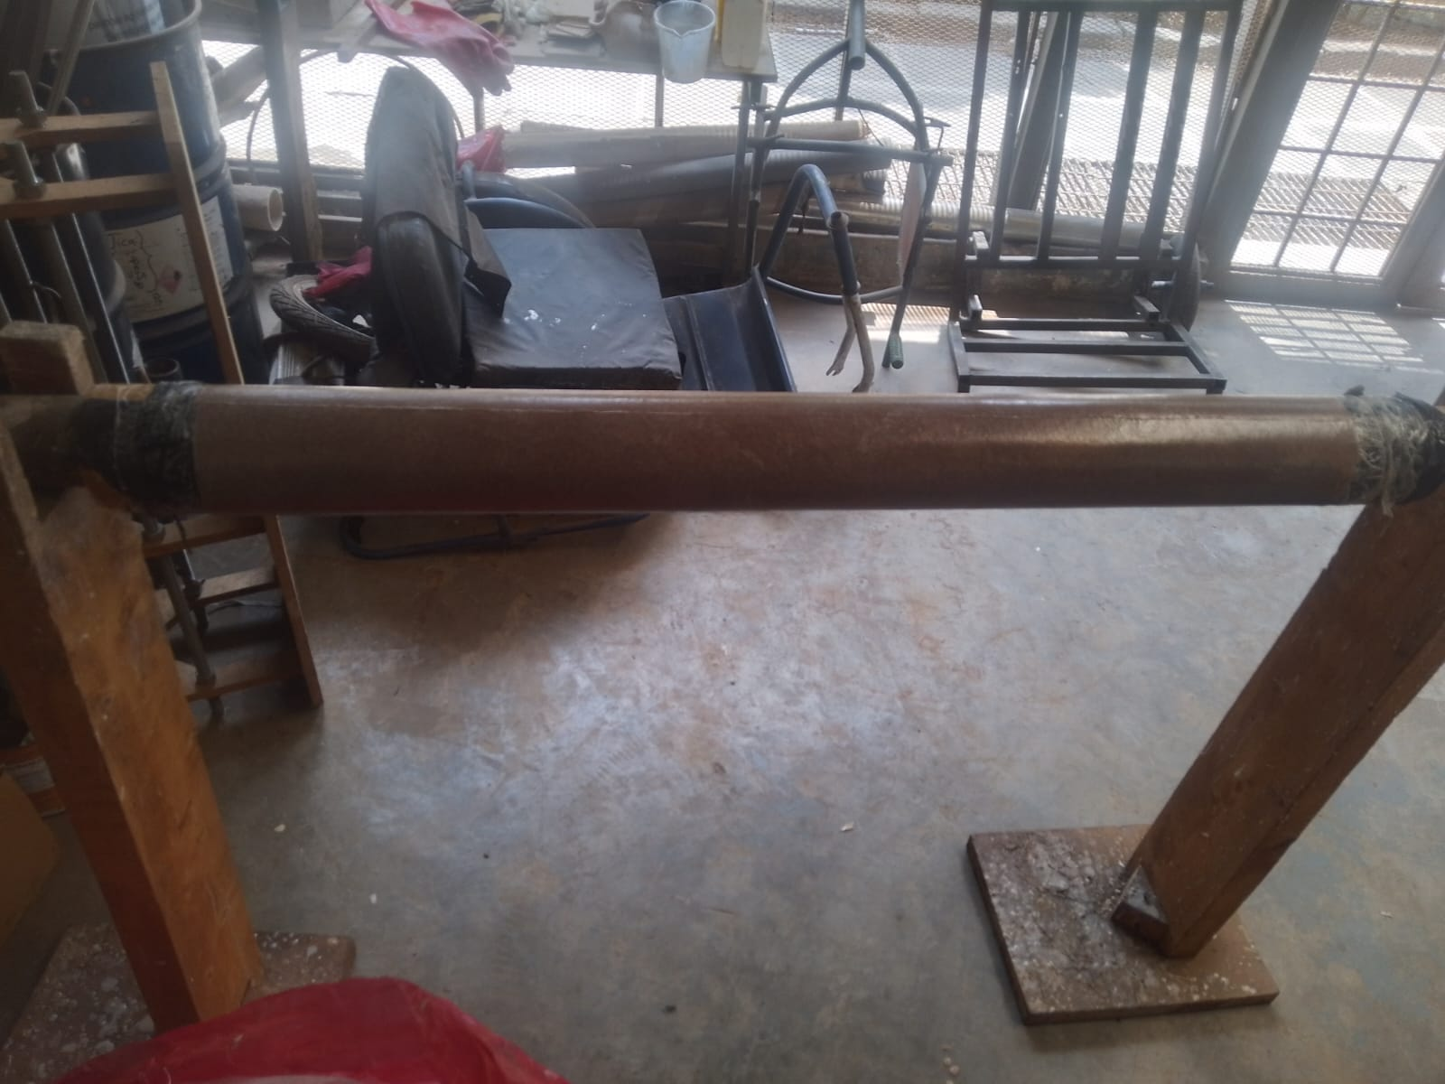
5. Liner preparation
Purpose: In preparation of the static tests campaign, we have fabricated 2 liners and both can fit the Aluminium and Stainless Steel fabrication.
Result: 3 out of 6 liners have been fabricated

Slide 8
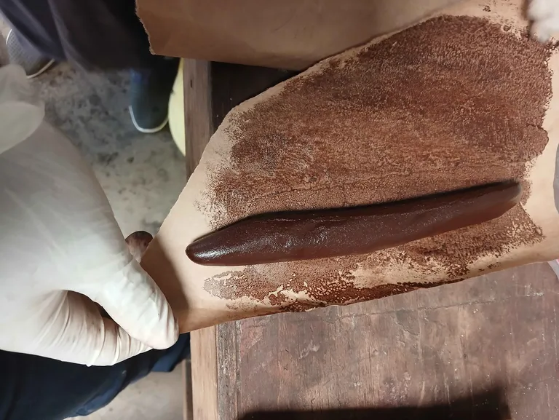
6. Ignitor preparation
Purpose: In preparation for the static test campaign (3, 4 & 5 grain), the propellant sub-team prepared 3 whole ignitors which will be subdivided by mass later (20 g is used per static test) and will be used during the upcoming static test.
Result:

Slide 9
This week's tasks
3 grain static test
Cooking of grains for 4 grain test (stainless steel) & 5 grain test (Aluminium)
Machining of core rods
Machining of nozzle and bulkhead for 4 grain stainless steel Solid Rocket Motor.

Slide 10
Challenges experienced
None
Supervisors’ note:
Visit Solid Propulsion github projects @ https://github.com/orgs/nakujaproject/projects/26 to review the tasks done.

Slide 11
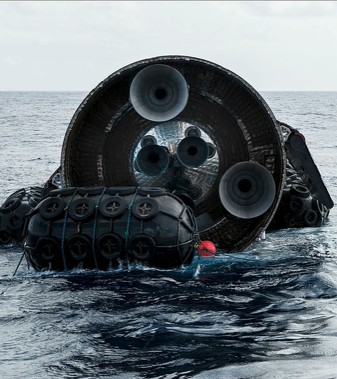
Thank you for your attention!

